Slide 1
ParkingRightService Design

Slide 2
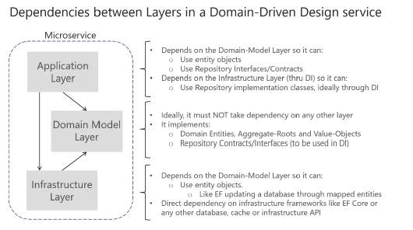
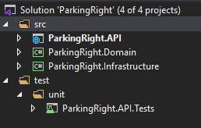
Project Structure
Project layers are designed with adopting Domain-Driven Design oriented Microservice architecture.
ParkingRight.Api - Provides an endpoint to register a parking right.
ParkingRight.Domain - Keeps domain entities which is developed with DDD pattern.
ParkingRight.Infrastructure – Repository implementation, infrastructure implementations used by application layer.

Slide 3
Solution
A REST API is created to be able to provide an endpoint for registration a parking right. A view model is defined to have a contract with the clients.
An aggregate is created for ParkingRight domain to adopt Domain-Driven Design on domain layer.
Infrastructure layer is designed by adopting Repository and UnitOfWork pattern. One repository is defined per aggregate.
EntityFrameworkCore is used on persistence layer to make the connection with mysql database.
Mysql database goes up with creating ParkingRights table which keeps registrations.

Slide 4
Next steps
Implement cross cutting concerns
  Logging
  Exception handling
  Validations
  Application insights integration
Implement notification raising ability
  Notifications needs be raised and put to a queue mechanism for the subscribers.

